Slide 1




YOUTUBE SONG ANALYSIS WITH POWER BI
Adeola Akinyan
MIP-DA-10

Slide 2



PROBLEM STATEMENT
This internship project aims to conduct a comprehensive analysis of YouTube songs data using Power BI. The dataset contains key attributes such as video ID, channel title, title, description, tags, published date, view count, like count, favorite count, comment count, video duration, video definition, and caption details. The goal is to utilize Power BI to create insightful visualizations and reports that provide a deeper understanding of YouTube songs' performance, popularity, and user engagement. The analysis aims to uncover trends, preferences, and patterns in the data to aid content creators and stakeholders in optimizing their YouTube song content.

Slide 3

DATASET DESCRIPTION
video_id: Unique identifier for each YouTube video.
channelTitle: Title of the YouTube channel publishing the song.
title: Title of the YouTube song video.
description: Description provided for the YouTube song video.
tags: Tags associated with the YouTube song video.
publishedAt: Date and time when the YouTube song video was published.
viewCount: Number of views received by the YouTube song video.
likeCount: Number of likes received by the YouTube song video.
favoriteCount: Number of times the YouTube song video has been marked as a favorite.
commentCount: Number of comments posted on the YouTube song video.
duration: Duration of the YouTube song video.
definition: Video definition or quality (e.g., HD, SD).
caption: Availability of captions for the YouTube song video.
SONG ANALYSIS WITH POWER BI
2024

Slide 4
PROJECT OBJECTIVES
Data Cleaning and Preparation:
- Clean and preprocess the dataset, handling missing values or outliers.
- Convert relevant columns to appropriate data types.
2. Exploratory Data Analysis (EDA):
- Explore patterns and distributions in view counts, like counts, and comments.
- Identify trends in the popularity and engagement of YouTube song videos.
3. Content and Channel Analysis:
- Analyze the distribution of videos across different channels.
- Identify popular tags and their correlation with view counts.
SONG ANALYSIS WITH POWER BI
2024

Slide 5
PROJECT OBJECTIVES
4. Temporal Trends:
- Explore how YouTube song video metrics vary over time.
- Identify peak publishing times and their impact on engagement.
5. User Engagement Insights:
- Investigate relationships between likes, comments, and views.
- Identify factors influencing user engagement with YouTube song videos.
SONG ANALYSIS WITH POWER BI
2024

Slide 6
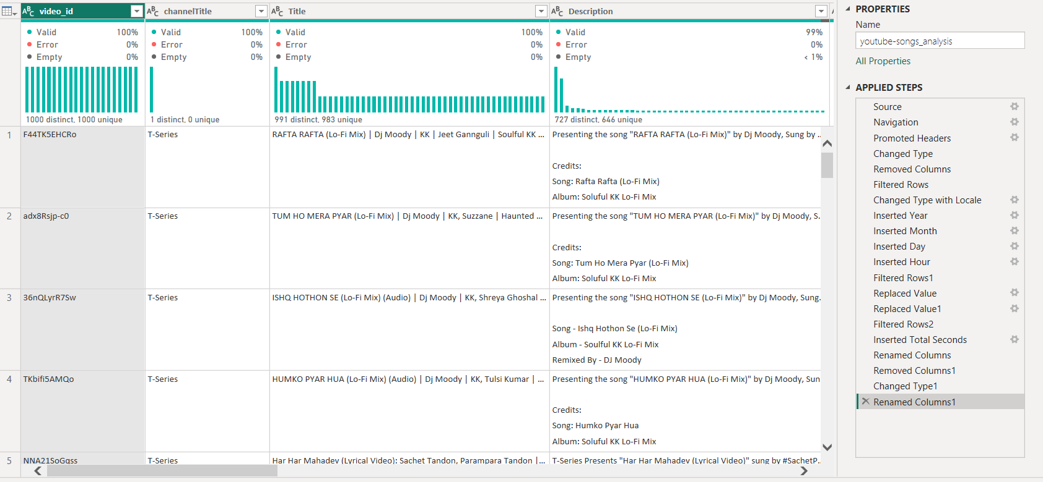
DATA TRANSFORMATION
The major transformations:
Changed data type
Inserted new columns
SONG ANALYSIS WITH POWER BI
2024

Slide 7
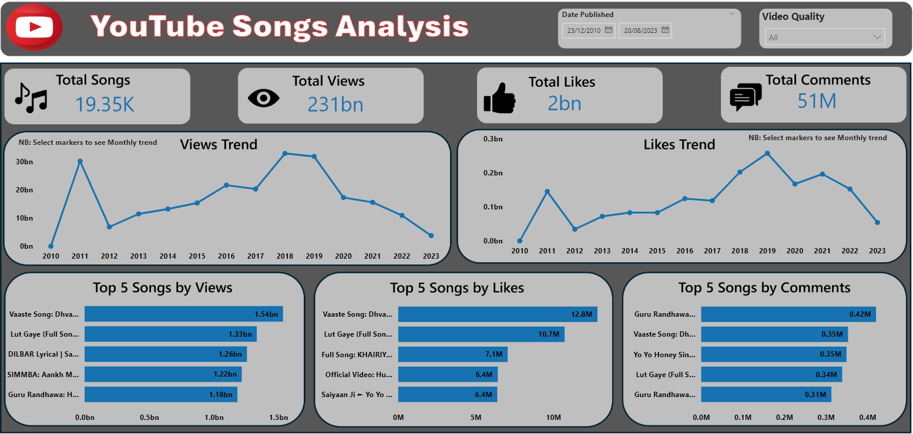
SONG ANALYSIS WITH POWER BI
2024

Slide 8

RECOMMENDATION
Respond to viewers' comments and discussions to keep them engaged.
Use appropriate tags to maximise visibility.
Upload at appropriate times and on a consistent schedule.
Publish more videos with High Definition (HD) quality to aid user engagement.
Work with other YouTube channels to cross-promote videos for a wider audience.
Modify the length of the video according to the viewer retention analysis.
Encourage subscriptions for updates.
Analyse metrics regularly.
Promote videos on other social media platforms.

Slide 9

Thank you
Adeola Akinyan
www.medium.com/@adeolaakinyan

